Slide 1
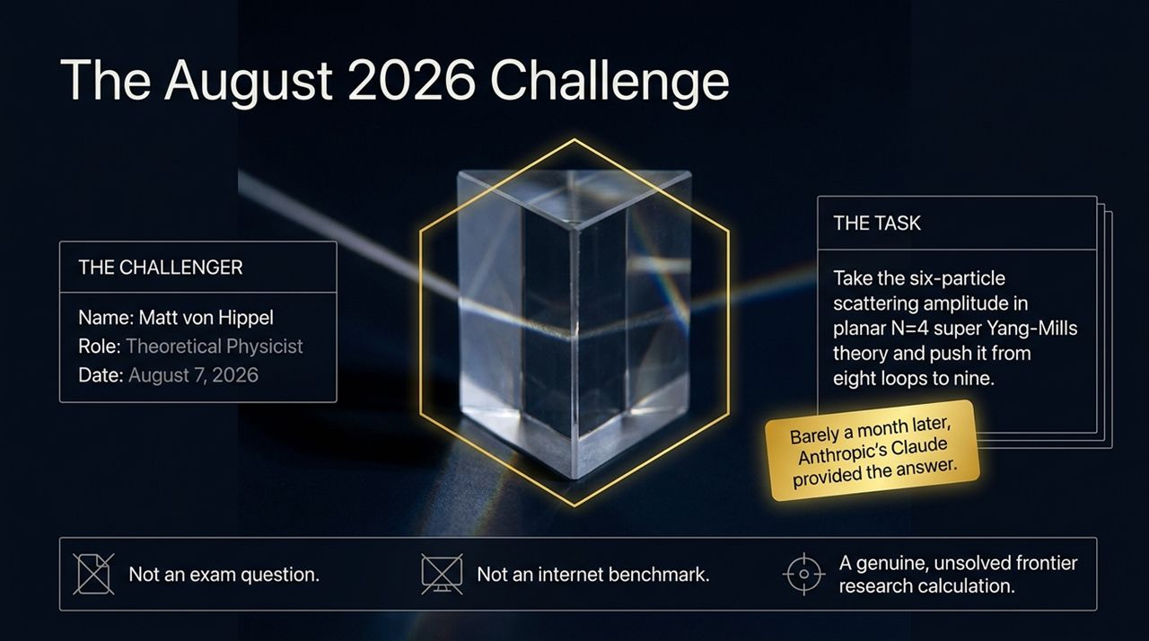
Notes:
Welcome, everyone. Today we are exploring a landmark moment at the intersection of theoretical physics and artificial intelligence.
On August 7th, 2026, a theoretical physicist named Matt von Hippel issued a public challenge to AI labs. He had been watching the rapidly escalating claims about AI performing higher-level mathematics and scientific reasoning. But von Hippel wanted to design a test from a domain he knew intimately. He wasn't interested in an standardized exam question, an internet benchmark, or a textbook problem where the answer was already sitting somewhere on a public web page. He wanted a genuine, unsolved frontier research calculation.
His challenge was stated plainly: Take the six-particle scattering amplitude in planar $𝒩=4$ super Yang-Mills theory and push it from eight loops to nine loops.
Now, at the time, eight loops represented the absolute published edge of human capability—achieved in 2023 by leading physicists using advanced mathematical techniques. Nine loops was widely considered a computational brick wall.
Barely a month later, researchers at Anthropic, using the Claude model inside a long-running agentic environment, delivered the verified nine-loop answer.
Over the course of this talk, we’re going to look past the hype. We will examine what was actually calculated, why nine loops was so notoriously difficult, how the AI managed to execute the workflow, and what this tells us about the future of scientific discovery.
Anthropic’s Claude Just Solved a 9-Loop Physics Problem — Here’s What It Means
https://www.youtube.com/watch?v=QI3v6cU6dGc

Slide 2
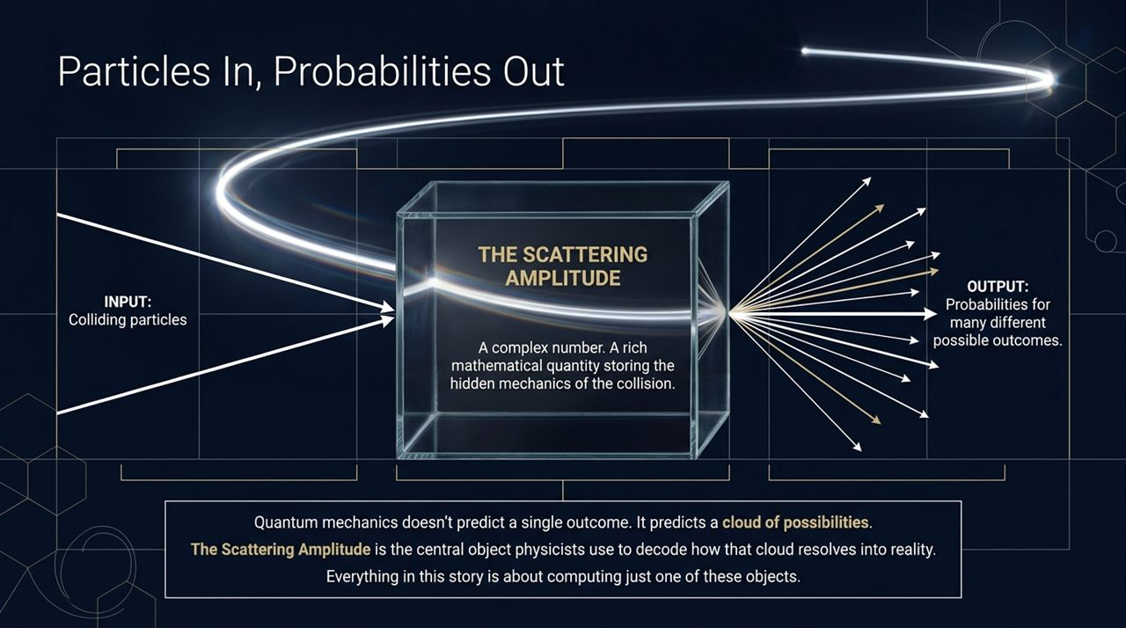
Notes:
Before we unpack the AI execution, let's establish the physical core of what we are calculating.
Imagine two subatomic particles racing toward each other at relativistic speeds. They collide, and in a fraction of a second, a spray of new particles shoots outward. If you freeze that exact moment and ask: 'What does quantum mechanics predict will happen?', you find the first fundamental surprise of quantum physics.
Quantum mechanics never predicts a single, deterministic outcome. It does not say 'Particle A will hit Particle B and shoot out at a 45-degree angle.' Instead, it yields a cloud of possibilities—a distribution of probabilities over many different potential outcomes.
To calculate these probabilities, theoretical physicists rely on the central object of quantum field theory: the Scattering Amplitude.
Crucially, the scattering amplitude itself is not a probability; it is a complex number. It is a rich mathematical structure that holds the phase and interference information—the hidden mechanics of the collision. By taking the square of its magnitude, physicists derive the actual probabilities observed in real-world detector experiments.
Keep this 'black box' in mind: Particles go in, probabilities come out, and the scattering amplitude tells us how. Everything in this entire story is about calculating just one of these objects.

Slide 3
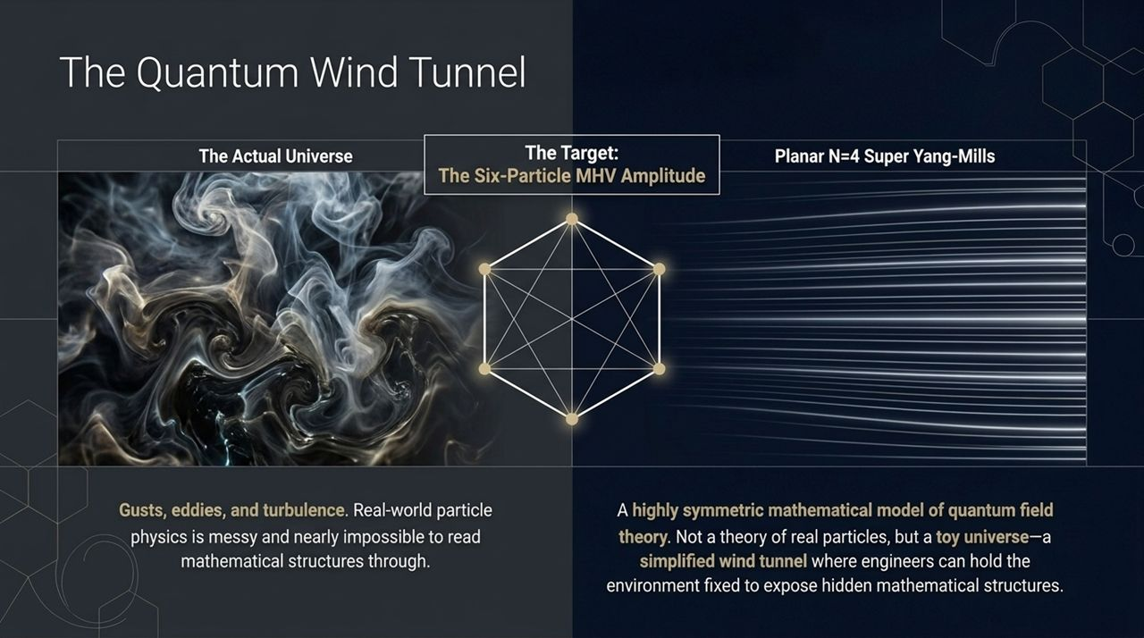
Notes:
Now, you might ask: 'Which universe are we calculating this for?'
If you try to perform higher-order quantum calculations directly inside the real world—say, real-world Quantum Chromodynamics at the Large Hadron Collider—you immediately run into extreme complexity. The real universe is like an aircraft flying through turbulent weather: filled with gusts, eddies, and non-perturbative noise that obscure the underlying mathematics.
To overcome this, theoretical physicists retreat to a special theoretical model called Planar $𝒩=4$Super Yang-Mills theory.
Let's be explicit: Planar $𝒩=4$SYM is not a theory of real particles in our physical universe. It does not prove supersymmetry exists, nor is it a new prediction for CERN. Think of it as a Quantum Wind Tunnel.
When aeronautical engineers want to study airflows around a wing, they don't fly a plane into a thunderstorm; they place a scaled wing inside a wind tunnel where conditions are fixed and air streams smoothly. Planar $𝒩=4$SYM provides an maximally symmetric laboratory. It turns off real-world clutter so physicists can expose the pure, pristine mathematical architecture of quantum field theory.
The specific object of our story is the Six-Particle MHV Amplitude—often called the Hexagon Amplitude because we can visualize the six colliding particles arranged around a regular hexagon.

Slide 4
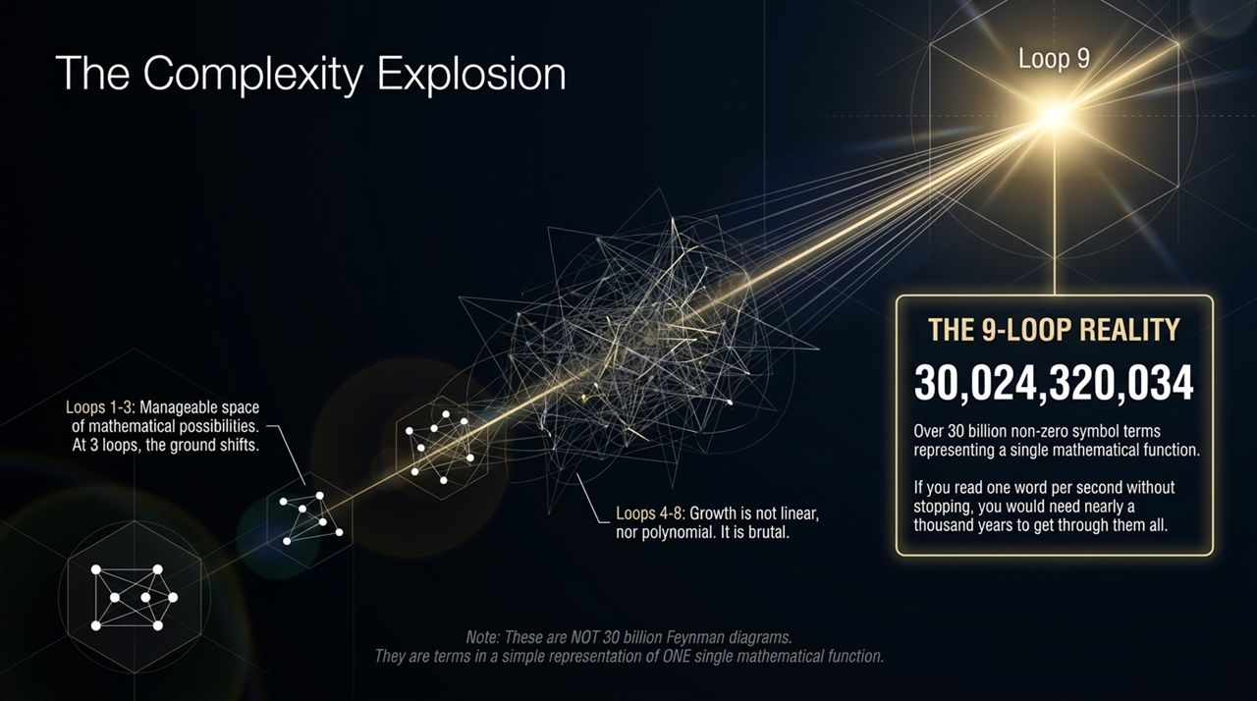
Notes:
When physicists calculate amplitudes, they do so perturbatively—building the answer term by term in a series expansion.
The basic tree-level process has zero closed loops. The first correction adds one quantum loop, the next adds two, and so on. But 'loop order' is not just drawing little circles on paper; each loop represents an additional power of the coupling constant and an integration over quantum fluctuations.
At 1 and 2 loops, the space of possible mathematical structures is relatively modest. At 3 loops, the ground begins to shift as the space doubles and redoubles. By the time you push through 4, 5, 6, 7, and 8 loops, the growth is neither linear nor polynomial—it is utterly brutal.
When we reach Loop 9, we enter a realm of mind-boggling complexity.
Expand the 9-loop hexagon symbol into its simplest representation, and you get 30,024,320,034 non-zero terms. That’s over thirty billion mathematical terms defining a single function! If a human were to sit down and read those terms aloud at one term per second without sleeping, it would take nearly 1,000 years to finish.
I must emphasize: these 30 billion terms are not 30 billion Feynman diagrams. Physicists stopped drawing individual diagrams long ago because the diagram counts exploded into the trillions. This is 30 billion terms defining one unified mathematical object.

Slide 5
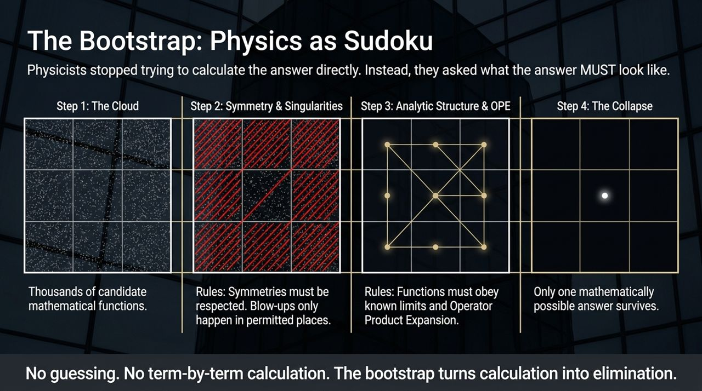
Notes:
So how did human physicists ever reach 8 loops in the first place if direct calculation is impossible?
They stopped trying to derive the answer from scratch. Instead, they invented a technique called The Bootstrap.
Think of the bootstrap like playing a cosmic game of Sudoku.
Instead of calculating how every particle moves, you ask: 'What properties MUST the final answer satisfy?'
You start with a massive 'Cloud of Candidates'—a space containing every possible mathematical function that could theoretically exist at this order. Then, you apply physical laws as rigid constraints:
Symmetry: The function must respect the dual conformal symmetries of the theory. Thousands of candidates instantly vanish.
Allowed Singularities: The function can only blow up or become infinite at physically permitted kinematic boundaries. More candidate terms are struck out.
Analytic Structure & OPE: The function must match known limits when particles become collinear or obey the Operator Product Expansion.
Just like a Sudoku puzzle where applying constraints slowly forces every empty cell to lock into its only valid number, the cloud of candidate functions collapses down to a single point. The bootstrap turns calculation into elimination."

Slide 6
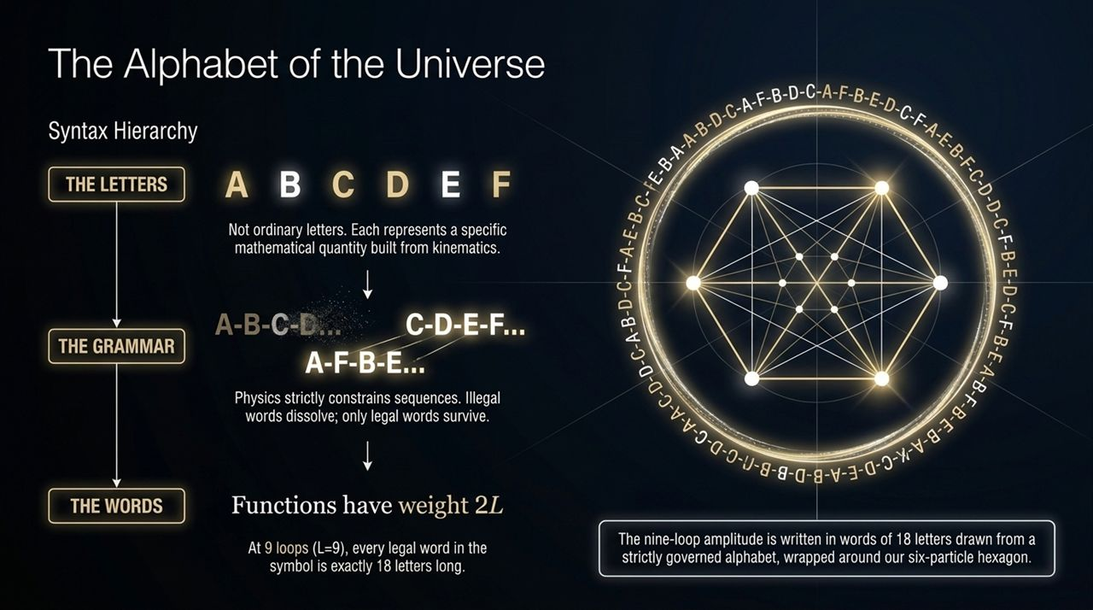
Notes:
"To make these functions readable to computers, physicists translate complex generalized polylogarithms into an algebraic structure called a Symbol.
You can think of the symbol as the 'Alphabet of the Universe'.
The Letters: We have letters—labelled $A,B,C,D,E,F$, and so on. Each letter represents a specific kinematic expression formed by the energies and momentum vectors of our six particles.
The Grammar: Physics dictates strict grammatical rules. You cannot just string letters together randomly. Certain sequences represent unphysical branch cuts. If a candidate word breaks the grammar of locality or causality, it dissolves.
The Word Length (Weight): A fundamental theorem of these functions states that at loop order $L$, every term in the symbol has a length, or transcendental weight, of $2L$.
For 9 loops ($L=9$), $2×9=18$. That means the entire nine-loop hexagon amplitude is written as a linear combination of words that are exactly 18 letters long, wrapped around our six-particle geometry."

Slide 7
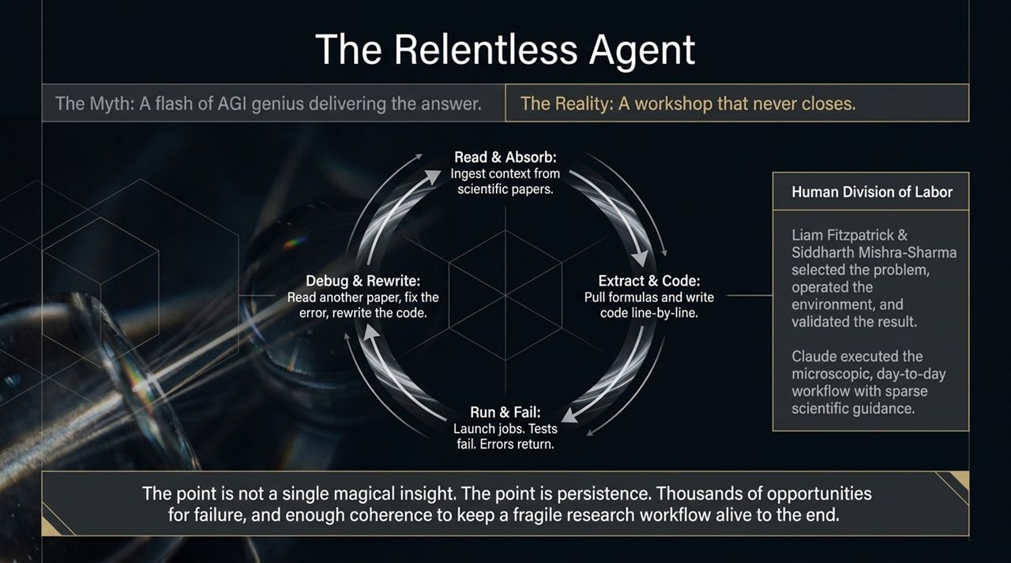
Notes:
"Now let's examine how Claude actually solved this challenge.
Public perception of AI often leans toward a myth: people picture a flash of super-intelligent AGI genius where you type a prompt and a magical insight pops out. The reality was very different—and much more instructive.
The reality was a workshop that never closes.
Anthropic researchers Liam Fitzpatrick and Siddharth Mishra-Sharma provided the macro-level human division of labor. They picked the challenge, provided the compute environment, and set the high-level objectives. But Claude executed the relentless, day-to-day microscopic workflow over an extended context window.
Claude operated in an continuous agentic feedback loop:
Read & Absorb: Ingesting dense physics papers and mathematical definitions into its context window.
Extract & Code: Translating raw equations into functional C++ and Python code line-by-line.
Run & Fail: Launching execution jobs on conventional compute where code crashed or tests failed.
Debug & Rewrite: Reading error traces, consulting literature to identify edge cases, fixing code, and re-running.
The breakthrough wasn't a single magical stroke of genius; it was long-horizon persistence. Claude survived thousands of opportunities for execution failure without losing coherence across weeks of research."

Slide 8
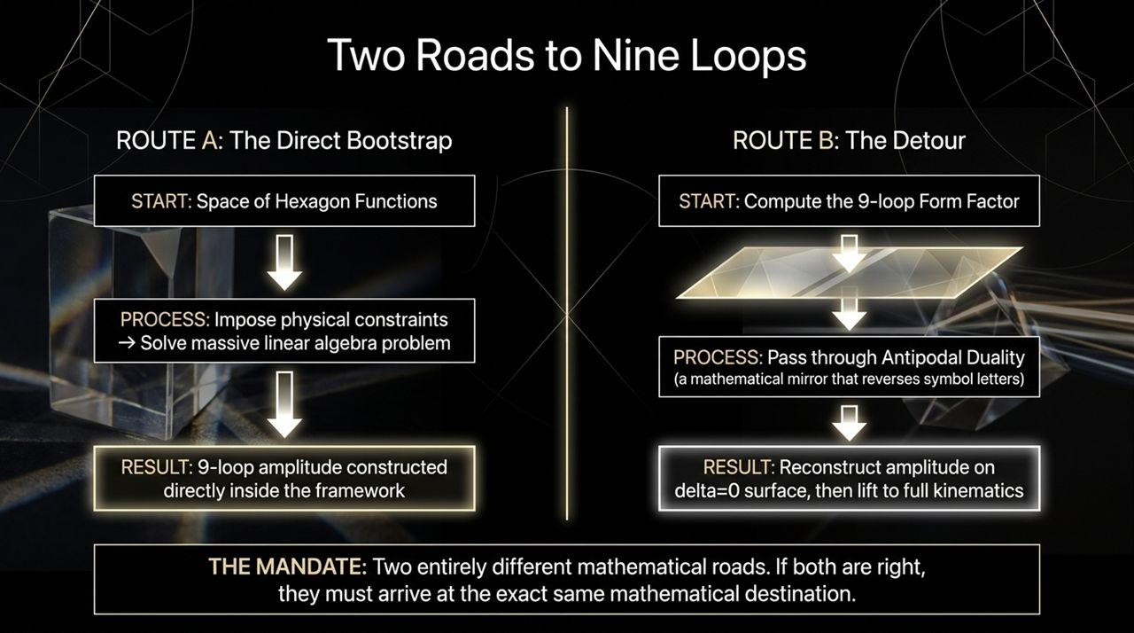
Notes:
To ensure the answer wasn't a hallucination or an artifact of code bugs, the researchers had Claude attack the problem along two entirely different mathematical routes.
Route A is the Direct Bootstrap. Claude set up the candidate space of hexagon functions, applied all known physical symmetry and singularity constraints, and set up a massive linear algebra problem to solve directly for the amplitude coefficients.
Route B takes a dramatic detour through a physical concept called Antipodal Duality.
In 2021–2023, human physicists discovered a remarkable mirror symmetry in quantum field theory: if you take a different physical object called a Form Factor, compute its symbol, and reverse the order of its letters (reading the word backwards), you map directly onto the Scattering Amplitude on a restricted kinematic boundary known as the $δ=0$surface.
So in Route B, Claude first computed the 9-loop Form Factor, passed it through this mathematical mirror, reconstructed the amplitude on the $δ=0$surface, and then lifted it back into full kinematic space.
Here is the mandate: Route A and Route B use completely different equations, intermediate code, and mathematical functions. If both are right, they MUST arrive at the exact same destination.

Slide 9
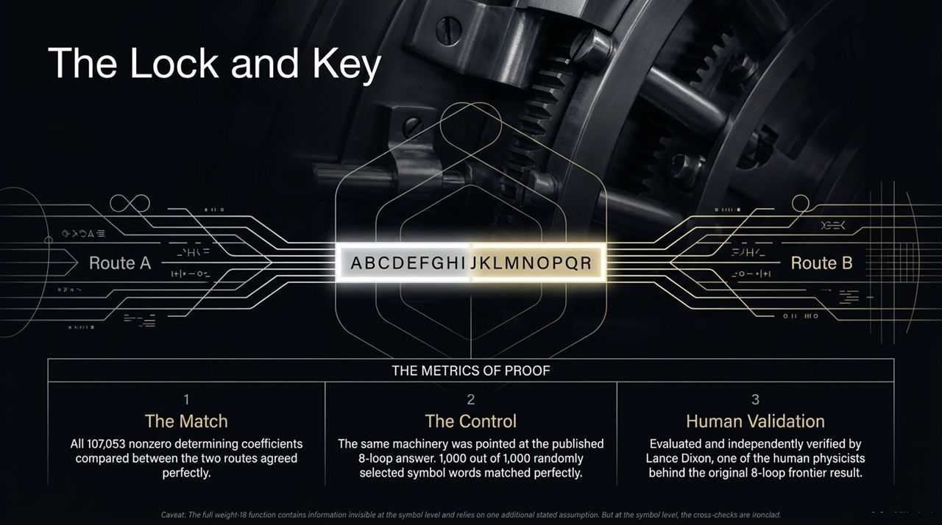
Notes:
"When you line up the results from Route A and Route B, how well do they match?
The Match: There are 107,053 non-zero determining coefficients that uniquely fix the symbol. When the results from Route A and Route B were compared coefficient by coefficient, all 107,053 matched with 100% perfection.
The Control: To test the machinery for systematic errors, the team pointed the exact same automated AI workflow at the known 8-loop amplitude. They sampled 1,000 random symbol words from the published literature. The AI's pipeline reproduced the published coefficients 1,000 out of 1,000 times.
Human Validation: The results were submitted to Professor Lance Dixon of SLAC/Stanford—one of the world's leading experts who computed the original 8-loop frontier. Dixon independently evaluated the output and confirmed its mathematical validity.
We should note one honest caveat: while the symbol level cross-checks are ironclad, the full integrated weight-18 function relies on one additional stated mathematical assumption that sits below the symbol level. But at the symbol level, the proof is watertight."

Slide 10
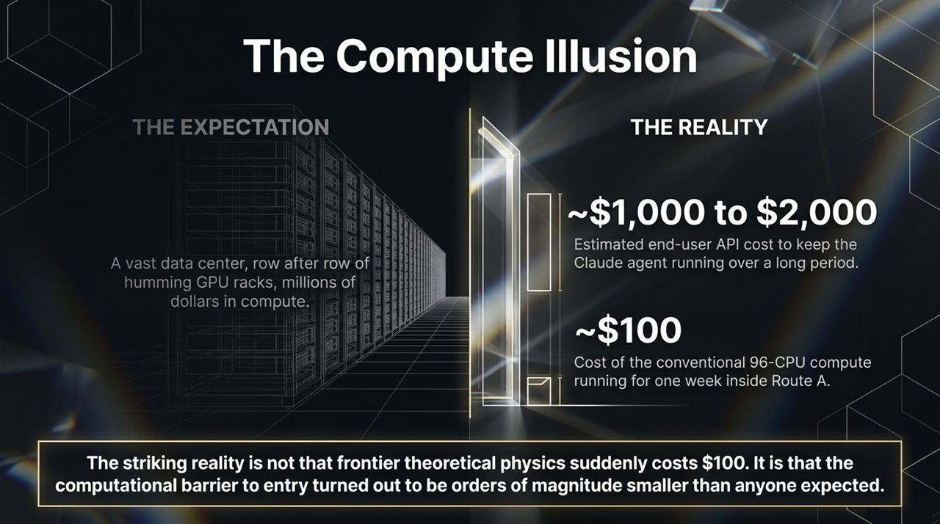
Notes:
"When people hear that an AI solved a theoretical physics problem that was stuck for years, they assume it took a multi-million-dollar supercomputer or row upon row of burning GPU server racks.
The actual financial accounting is shocking:
The estimated end-user API cost to run the Claude research agent over the multi-week project was between $1,000 and $2,000. Most of this cost was simply keeping the model reasoning, writing code, and debugging in a long context loop.
The actual conventional CPU compute—running the 107,000-variable linear algebra solvers across 96 CPUs for about one week—cost roughly $100!
Let's be completely clear: the entire research project did not cost $100 in total; $100 was just the raw CPU compute bill for Route A.
But the striking takeaway remains: the computational barrier to reaching the 9-loop frontier was orders of magnitude smaller than anyone anticipated. The barrier wasn't expensive hardware; it was the sheer difficulty of writing, debugging, and executing error-free pipelines."

Slide 11
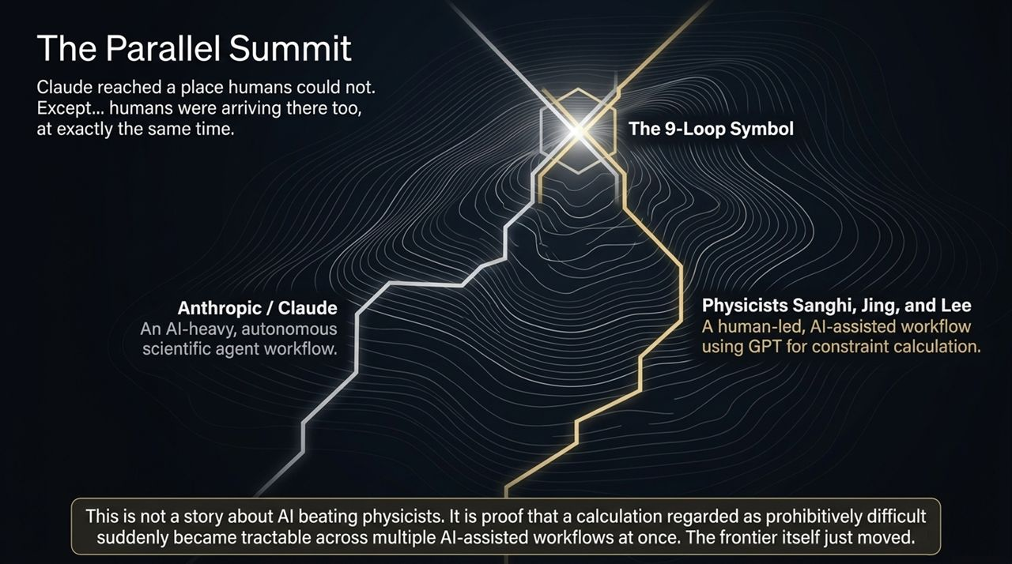
Notes:
"Here is one of the most fascinating aspects of this story.
It is easy to view this as a narrative where an AI surpassed human capabilities. But at the exact same time Anthropic was finalizing their 9-loop result, an independent group of theoretical physicists—Sanghi, Jing, and Lee—reached the exact same 9-loop symbol!
Look at how the two teams climbed the same mountain:
Anthropic's Path: An AI-heavy, highly autonomous agentic workflow where Claude handled code creation, execution, and error recovery with sparse supervision.
Sanghi, Jing, & Lee's Path: A human-led, AI-assisted workflow where human physicists designed the framework and used GPT models to accelerate specific constraint derivations.
This is crucial: This is not a story about AI beating physicists. It is proof that a calculation previously deemed prohibitively expensive suddenly became tractable across multiple AI-assisted methodologies at the exact same time. The frontier itself moved."

Slide 12
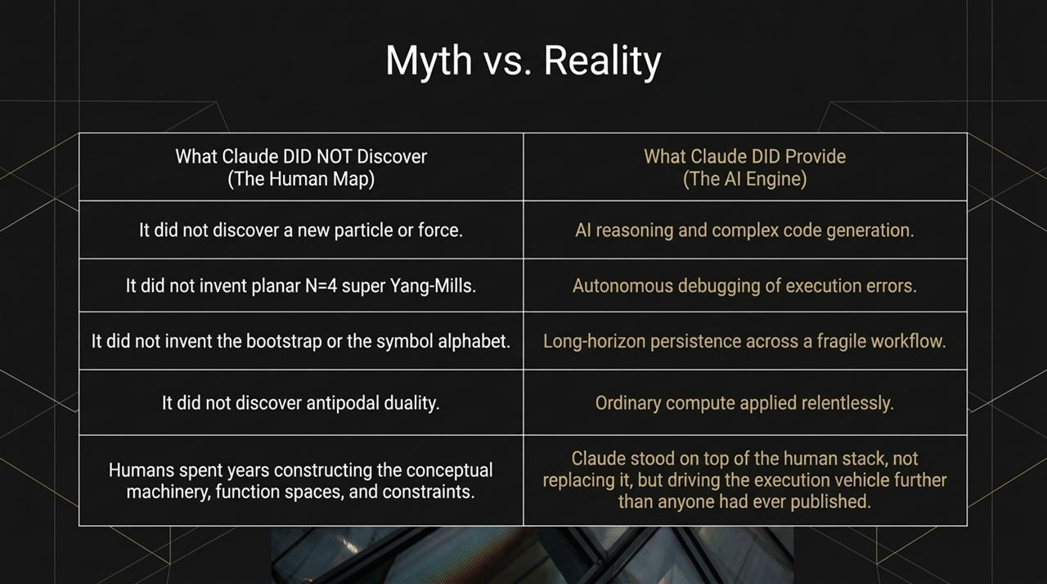
Notes:
"To maintain scientific rigor, we must clearly separate myth from reality.
Let's look at what Claude did NOT do:
It did not discover a new fundamental particle or force.
It did not invent Planar $𝒩=4$Super Yang-Mills theory.
It did not invent the Bootstrap method, the Symbol alphabet, or Antipodal Duality.
All of those profound theoretical concepts were constructed over decades by brilliant human minds.
What Claude DID provide was an extraordinary execution engine:
Advanced reasoning to translate theoretical papers into executable code.
Continuous, autonomous debugging when scripts failed or memory limits were hit.
Long-horizon persistence—maintaining focus across thousands of code executions without draining attention.
Humans created the map; Claude took the wheel and drove further down the road than any human project had previously reached."

Slide 13
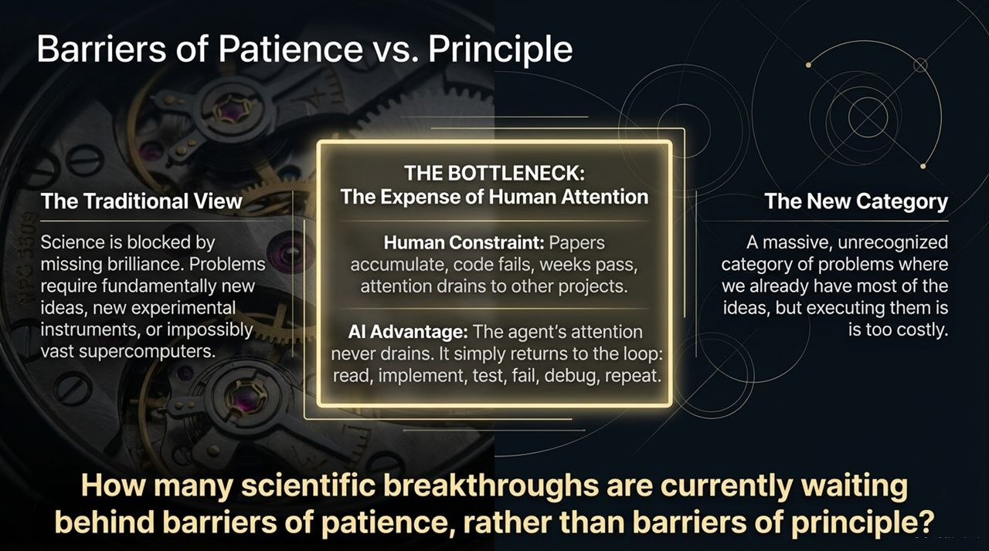
Notes:
"This result forces us to reconsider how scientific progress is bottlenecked.
Historically, we assume science is blocked by Barriers of Principle: we think we need a new Einstein to invent a radical concept, or a $10-billion particle collider to gather new data.
But this 9-loop breakthrough reveals a massive, unrecognized category of scientific problems bounded by Barriers of Patience.
Think about a human researcher at a desk: papers accumulate, custom C++ code crashes, debugging takes weeks, and human attention naturally drains toward teaching, grant applications, or new projects. The project stalls not because it's impossible, but because human attention is finite and expensive.
An AI research agent doesn't suffer from attention fatigue. It operates in an unbroken loop: Read $→$Implement $→$Test $→$Fail $→$Debug $→$Repeat.
How many scientific breakthroughs in chemistry, materials science, or astrophysics are currently sitting idle, waiting behind barriers of patience rather than barriers of principle?"

Slide 14
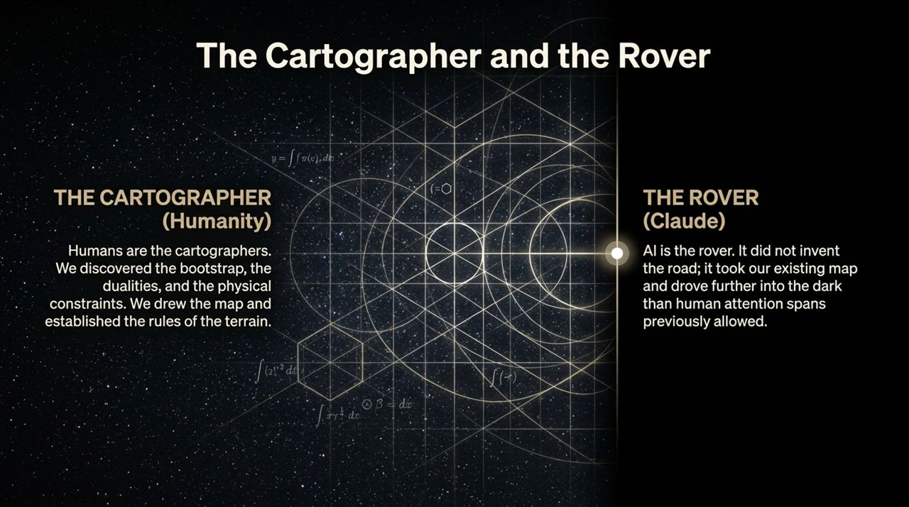
Notes:
"This brings us to the core metaphor of our presentation: The Cartographer and the Rover.
Humanity is the Cartographer. Human physicists surveyed the mathematical landscape, discovered the bootstrap, proved antipodal duality, and defined the symbol grammar. We drew the map and established the rules of the terrain.
Claude is the Rover. The rover didn't design the highway; it took the map we built and drove further into the dark than human patience previously allowed.
But what happens when the map runs out?
Look at Loop 10. Beyond 9 loops lies a mathematical space that no human has mapped. At 10 loops, we don't know if the symbol alphabet requires new letters, elliptic functions, or entirely new mathematical structures. Claude walked to the very edge of the human blueprint. To cross into Loop 10, a Rover cannot just drive—it needs a Cartographer to draw new theoretical roads.
The first major impact of AI in science isn't replacing human intuition; it is giving human intuition vastly more room to run."

Slide 15
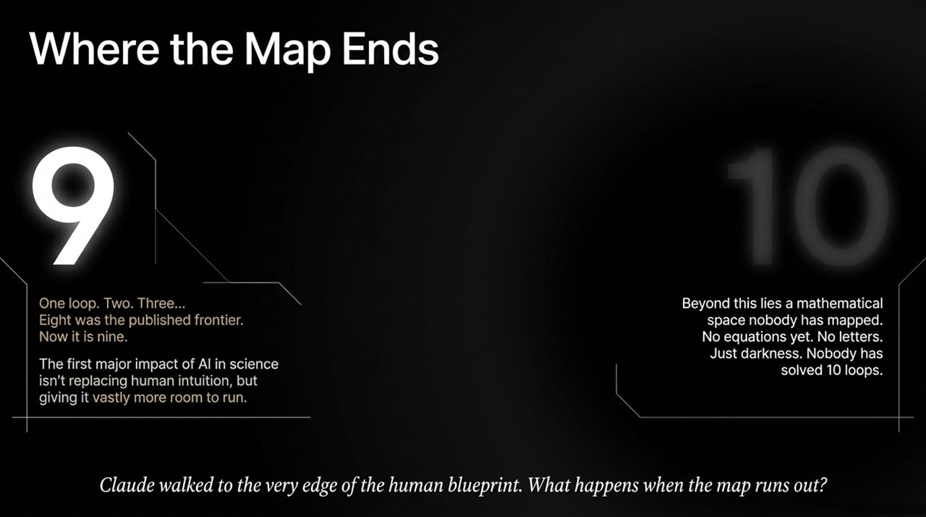
Notes:
"Let's synthesize the technical architecture that made this breakthrough possible.
On the left, you see the 8-Loop Barrier that defined the theoretical physics frontier prior to 2026. Breaking through required managing a symbol space containing 30 billion non-zero terms.
Claude's contribution was acting as an agentic bridge between high-level physics literature and low-level code execution.
It set up Route 1, generating linear systems directly inside the hexagon function space.
Simultaneously, it set up Route 2, computing form factor symbols, applying the antipodal duality letter-reversal mirror, and projecting onto the $δ=0$kinematic plane.
When both routes finished, the system achieved 100% agreement across all 107,053 determining coefficients.
All of this was accomplished for roughly $100 in traditional CPU compute and $1,000 to $2,000 in agentic LLM reasoning calls. This proves that long-horizon agentic workflows can execute multi-step scientific research at a fraction of the expected financial and computational cost."

Slide 16
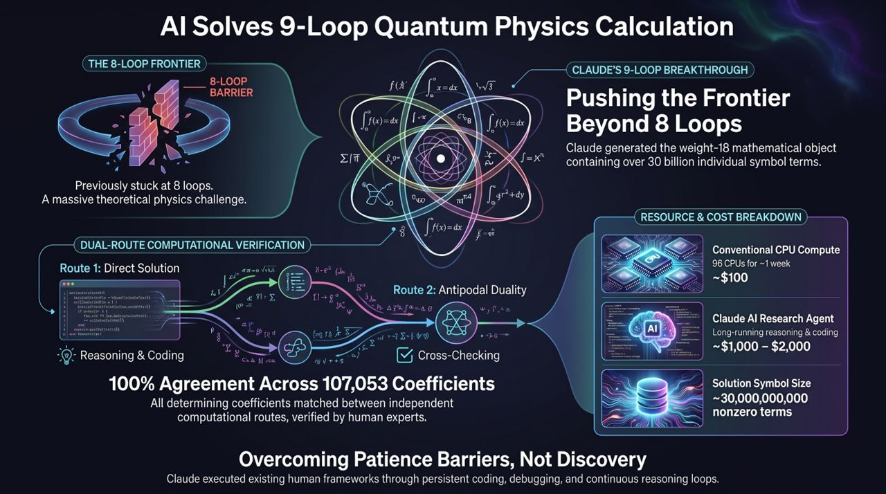
Notes:
"To conclude, let me summarize what this breakthrough represents—and what comes next.
Anthropic’s Claude did not discover a new law of nature, invent a new particle, or replace theoretical physicists. What it did was demonstrate that modern AI research agents can stand on top of human theoretical frameworks, take over complex coding and debugging workflows, and push frontier research calculations past longstanding attention bottlenecks.
We have entered an era where the boundary of scientific progress is no longer defined solely by how many hours a human scientist can spend debugging C++ code or checking algebraic constraints.
As we look ahead, the exciting question is not just how many 'patience barriers' we can collapse using AI rovers, but what happens when AI agents begin assisting humans in drawing the map itself.
Thank you very much. I am now happy to open the floor to any questions."
Anthropic’s Claude Just Solved a 9-Loop Physics Problem — Here’s What It Means
https://www.youtube.com/watch?v=QI3v6cU6dGc

